Slide 1



Color fundamentals and processing

Slide 2
What is color?
A psychological property of our visual experiences when we look at objects and lights.
Not a physical property of those objects or lights.
Color is the result of interaction between physical light in the environment and our visual system.
S. Palmer, Vision Science: Photons to Phenomenology, The MIT Press, 1999.

Slide 3
Colour, also spelled color, the aspect of any object that may be described in terms of hue, lightness, and saturation. In physics, colour is associated specifically with electromagnetic radiation of a certain range of wavelengths visible to the human eye.

Slide 4
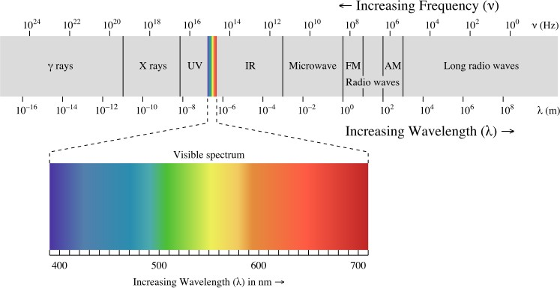
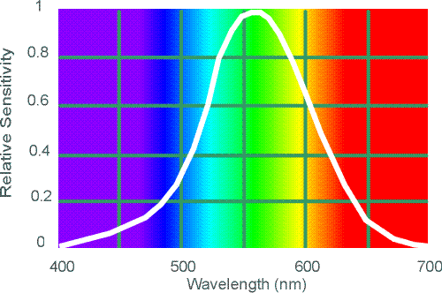
Electromagnetic spectrum
Human Luminance Sensitivity Function

Slide 5
The Physics of Light
Any source of light can be completely described physically by its spectrum: the amount of energy emitted (per time unit) at each wavelength 400 - 700 nm.
Relative spectral power
400 500 600 700
Wavelength (nm.)
# Photons
(per ms.)
© Stephen E. Palmer, 2002

Slide 6
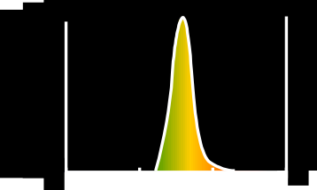

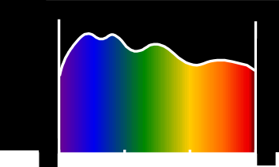
The Physics of Light
Some examples of the spectra of light sources
A. Ruby Laser B. Gallium Phosphide Crystal
Rel. power
Rel. power
# Photons
# Photons
400 500 600 700
400 500 600 700
Wavelength (nm.)
Wavelength (nm.)
C. Tungsten Lightbulb
D. Normal Daylight
Rel. power
Rel. power
# Photons
# Photons
400 500 600 700
400 500 600 700
© Stephen E. Palmer, 2002

Slide 7

Black body radiators
Construct a hot body with near-zero albedo (black body).
Easiest way to do this is to build a hollow metal object with a tiny hole in it, and look at the hole.
The spectral power distribution of light leaving this object is a simple function of temperature.
This leads to the notion of color temperature
the temperature of a black body that would look the same.
Courtesy: Computer Vision - A Modern Approach: Color Slides by D.A. Forsyth

Slide 8
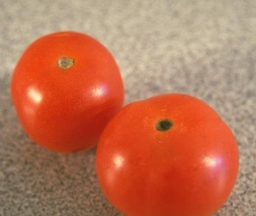
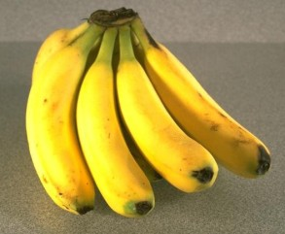
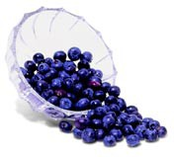
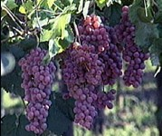
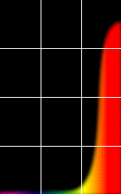
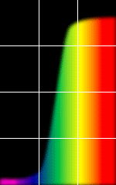
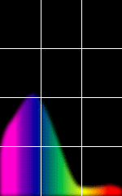
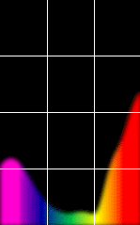
Reflection of Light
Some examples of the reflectance spectra of surfaces
% Light Reflected
Red
Yellow
Blue
Purple
400 700 400
700 400
Wavelength (nm)
700 400 700
© Stephen E. Palmer, 2002

Slide 9
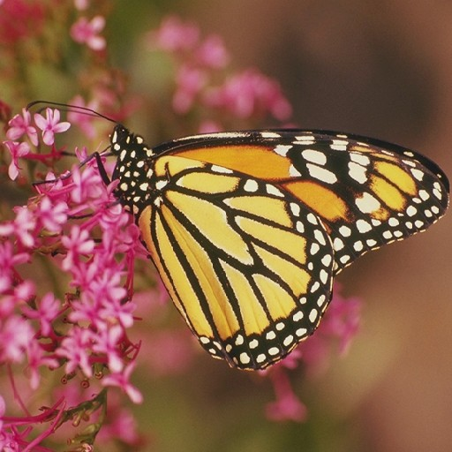
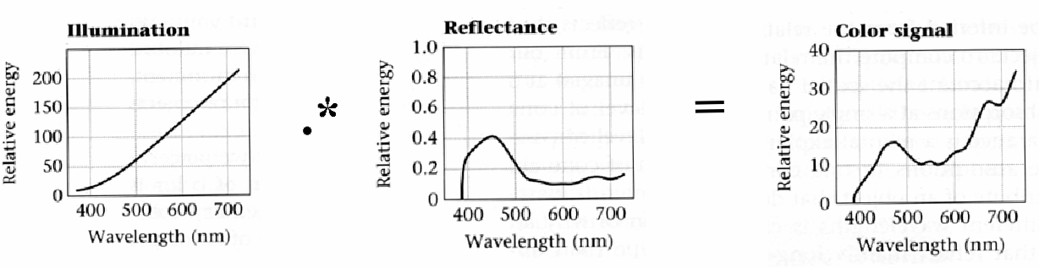
Interaction of light and surfaces
Observed color is the result of interaction of light source spectrum with surface reflectance.

Slide 10
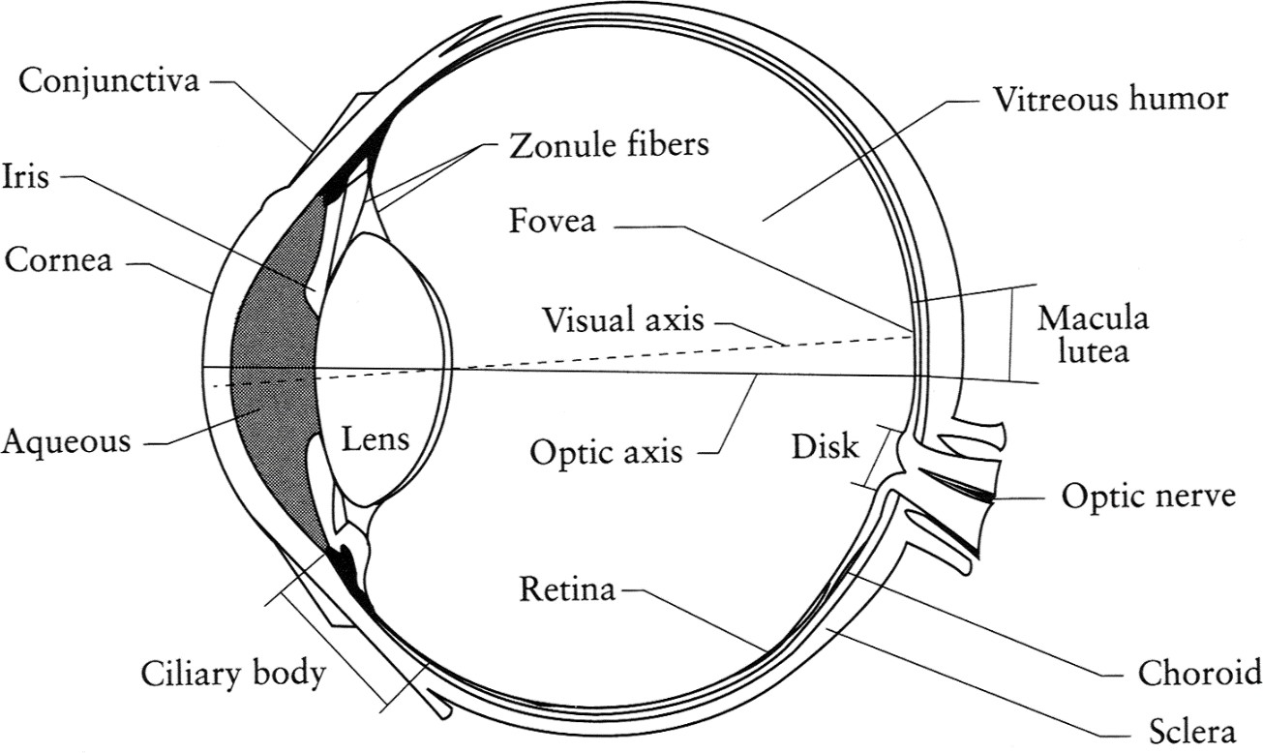
The Eye: A Camera!
Iris - colored annulus with radial muscles
Pupil - the hole (aperture), size controlled by the iris.
Retina -photoreceptor cells (rods and cones) acting like the film or array of sensors of a camera.
Lens - changes shape by using ciliary muscles for focusing on objects of interest.
Adapted from slides by Steve Seitz.

Slide 11
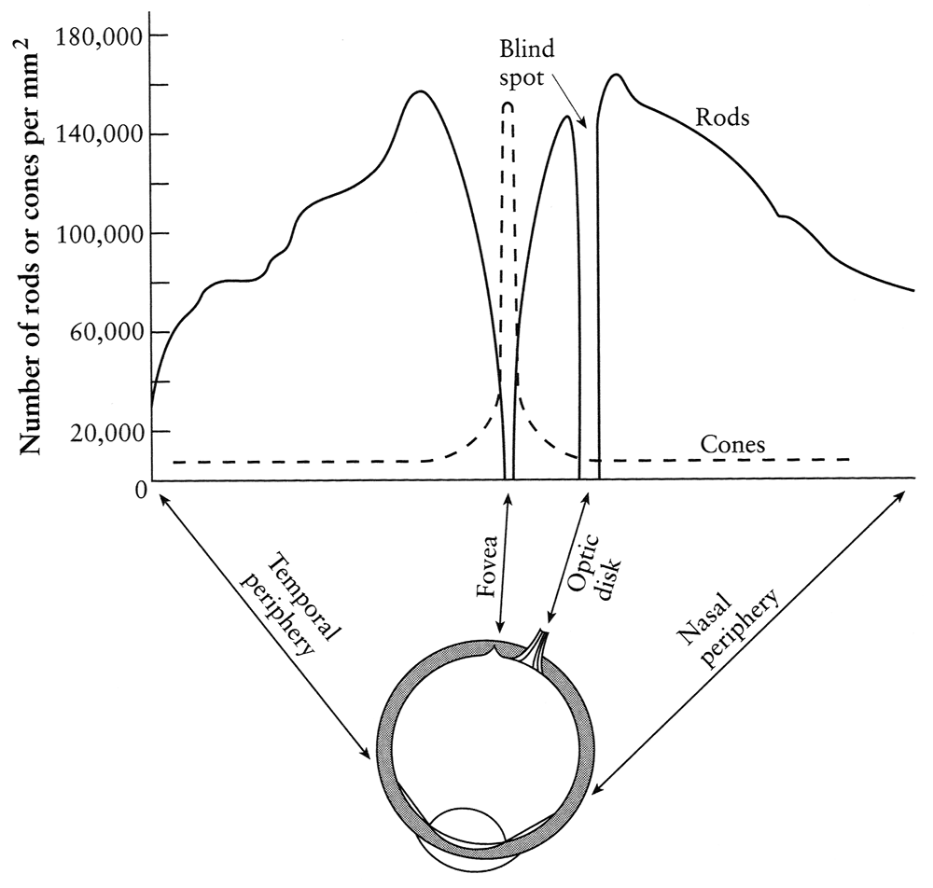
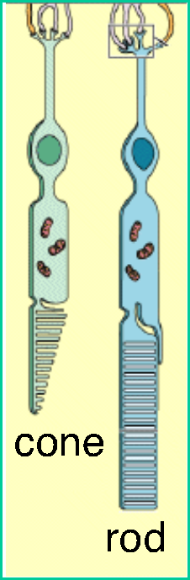
Density of rods and cones
Rods and cones are non-uniformly distributed on the retina
Rods responsible for intensity, cones responsible for color
Fovea - Small region (1 or 2°) at the center of the visual field containing the highest density of cones (and no rods).
Less visual acuity in the periphery—many rods wired to the same
neuron
Slide by Steve Seitz

Slide 12
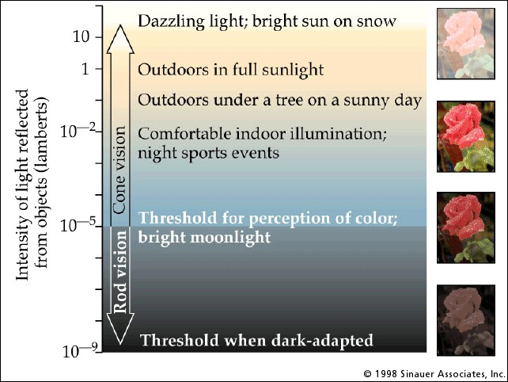
Rod / Cone sensitivity
The candela is the luminous intensity, in a given direction, of a source that emits monochromatic radiation of frequency 540×10¹² hertz and that has a radiant
1 lambert (L) = candela per
square centimetre (0.3183 cd/cm²) or
cd m⁻²
intensity in that direction of ¹⁄₆₈₃ watt per steradian.
As cone vision is not activated in low illumination, we are unable to read.
Adapted from slides by A. Efros

Slide 13
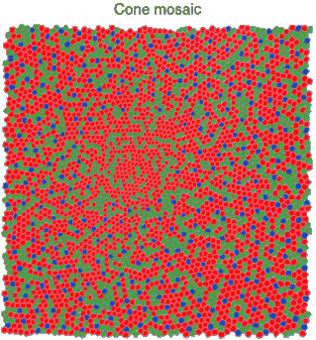
Physiology of Color Vision
Three kinds of cones:
440 530 560 nm.
100
RELATIVE ABSORBANCE (%)
S
M L
50
400 450 500 550 600 650
WAVELENGTH (nm.)
Ratio of L to M to S cones: approx. 10:5:1
Almost no S cones in the center of the fovea
© Stephen E. Palmer, 2002

Slide 14
Color perception
M L
Power
S
Wavelength
Entire spectrum (of reflected energy from an object or energy of an illuminant) represented by 3 numbers.
Even different spectra may have same representation and thus indistinguishable.
such spectra called metamers.
Adapted from slides by Steve Seitz.

Slide 15
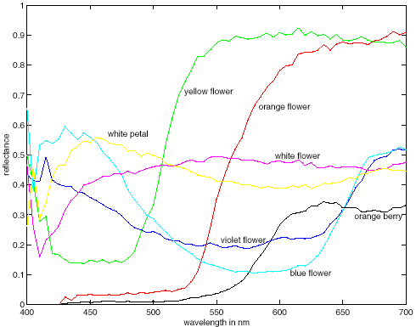
Spectra of some real-world surfaces
metamers
Adapted from slides by Steve Seitz.

Slide 16
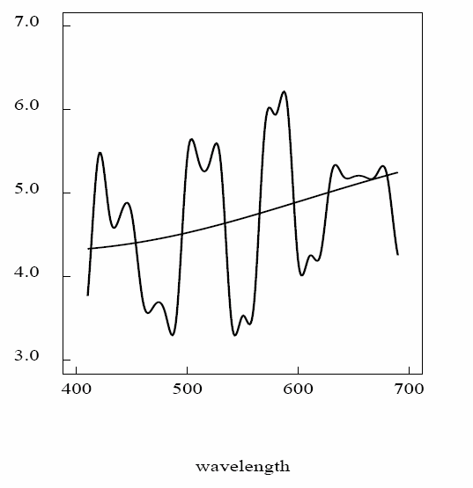
Metamers: Colors that look the same (P), but have different spectra (L1, L2)

Slide 17
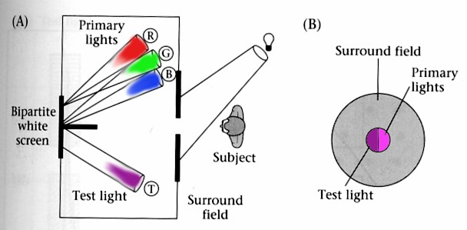
Standardizing color experience
To understand which spectra produce the same color sensation under similar viewing conditions.
Color matching experiments.
Foundations of Vision, by Brian Wandell, Sinauer Assoc., 1995

Slide 18
Trichromacy
In color matching experiments, most people can match any given light with three primaries.
Primaries must be independent.
For the same light and same primaries, most people select the same weights.
Exception: color blindness
Trichromatic color theory
Three numbers seem to be sufficient for encoding color.
Dates back to 18th century (Thomas Young).
Adapted from W. Freeman

Slide 19
Grassman’s Laws
Color matching appears to be linear.
If two test lights can be matched with the same set of weights, then they match each other:
If A = u₁P₁ + u₂P₂ + u₃P₃ and B = u₁P₁ + u₂P₂ + u₃P₃. Then A = B.
If we mix two test lights, then mixing the matches will match the result:
If A = u₁P₁ + u₂P₂ + u₃P₃ and B = v₁P₁ + v₂P₂ + v₃P₃. Then A+B = (u₁+v₁) P₁ + (u₂+v₂) P₂ + (u₃+v₃) P₃.
If we scale the test light, then the matches get scaled by the same amount:
If A = u₁P₁ + u₂P₂ + u₃P₃, then kA = (ku₁) P₁ + (ku₂) P₂ + (ku₃) P_{3.}
Adapted from W. Freeman

Slide 20
Linear color spaces
mixing two lights produces
colors that lie along a straight
line in color space.
Defined by a choice of three primaries
The coordinates of a color are given by the weights of the primaries used to match it.
Matching functions: weights required to match single-wavelength light sources.
mixing three lights produces colors that lie within the triangle they define in color space.
Adapted from W. Freeman

Slide 21
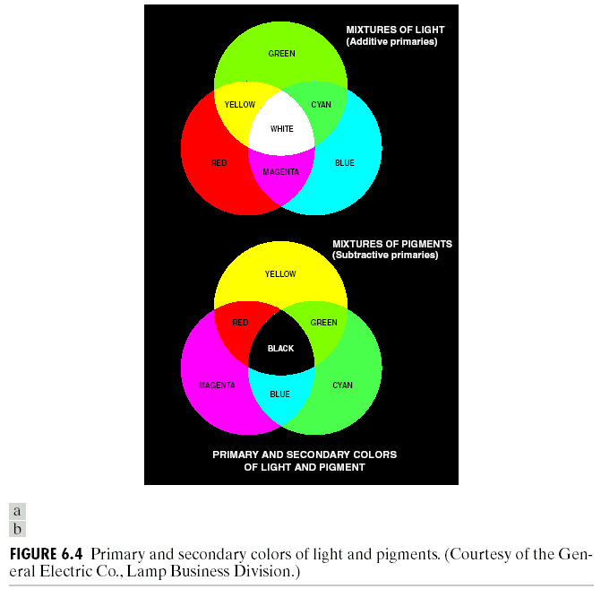
Additive and subtractive colors
Adapted from Gonzales and Woods

Slide 22
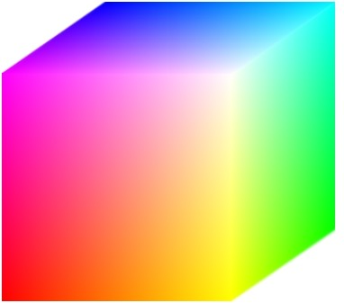
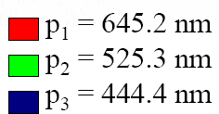
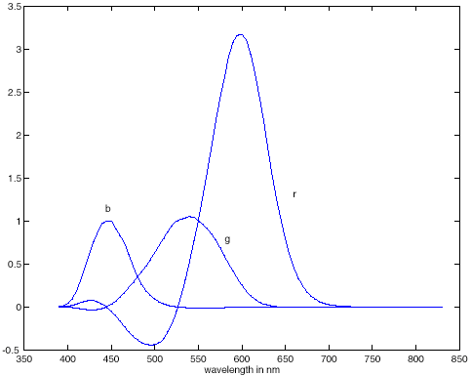
Linear color spaces: RGB
Primaries are monochromatic lights (for monitors, they correspond to the three types of phosphors).
Subtractive matching required for some wavelengths.
RGB matching functions

Slide 23
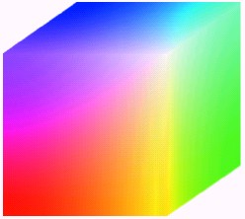
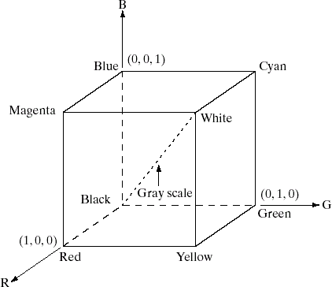
RGB model
Additive model.
An image consists of 3 bands, one for each primary color.
Appropriate for image displays.
Adapted from Gonzales and Woods

Slide 24
CMY model
Inks: Cyan=White-Red, Magenta=White-Green, Yellow=White-Blue.
Cyan-Magenta-Yellow is a subtractive model which is good to model absorption of colors.
Appropriate for paper printing.
Adapted from Octavia Camps, Penn State

Slide 25
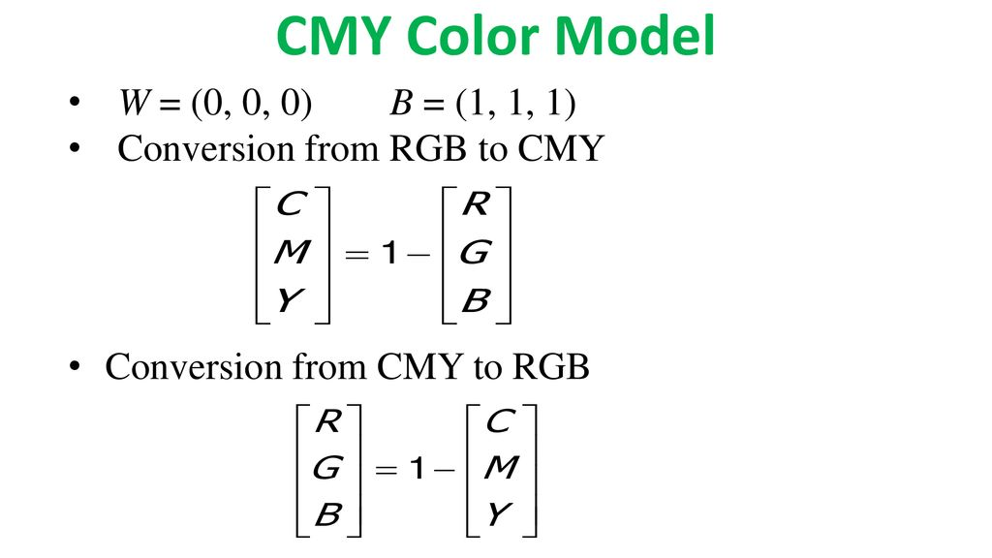

Slide 26
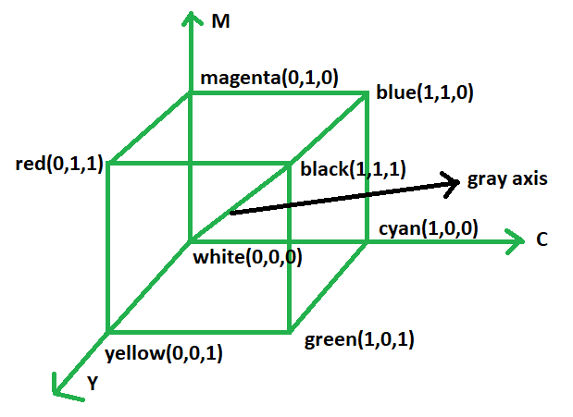
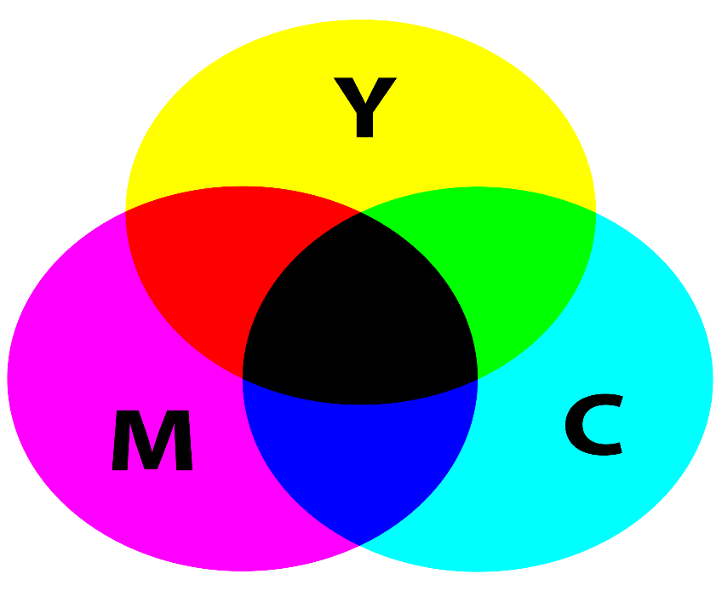
C = 1 - R
M =1 - G
Y = 1 - B

Slide 27
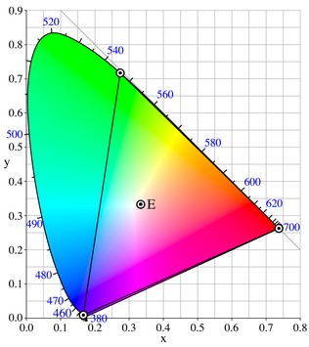
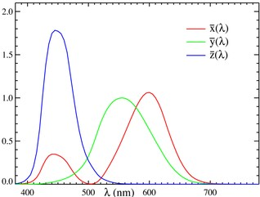
CIE XYZ: Linear color space
Primaries are imaginary, but matching functions are everywhere positive
2D visualization: draw (x,y), where
x = X/(X+Y+Z)
y = Y/(X+Y+Z)
Matching functions
http://en.wikipedia.org/wiki/CIE_1931_color_space

Slide 28
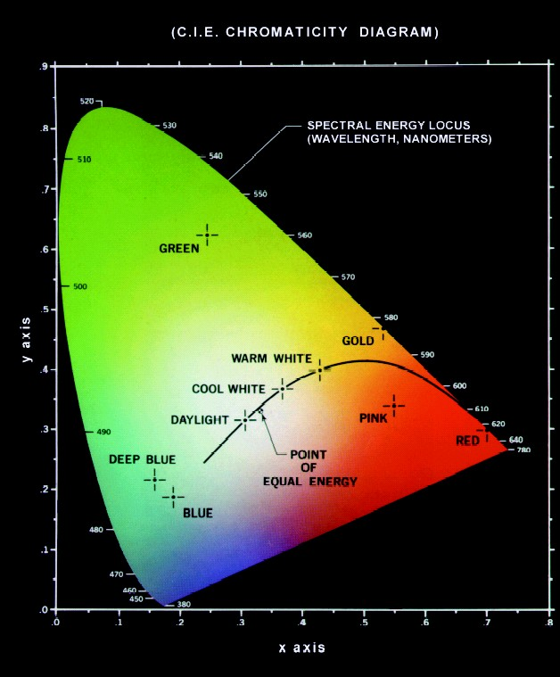
CIE chromaticity model
x, y, z normalize X, Y, Z such that
x + y + z = 1.
Actually only x and y are needed because
z = 1 - x - y.
Pure colors are at the curved boundary.
White is (1/3, 1/3, 1/3).
Adapted from Octavia Camps, Penn State

Slide 29
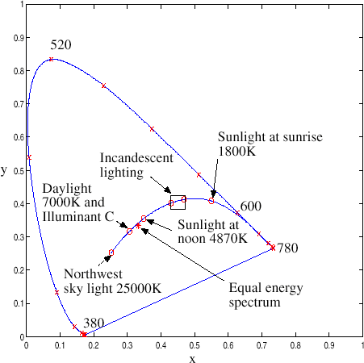
Spectral locus of monochromatic lights and the heated black- bodies
Computer Vision - A Modern Approach Color Slides by D.A. Forsyth

Slide 30
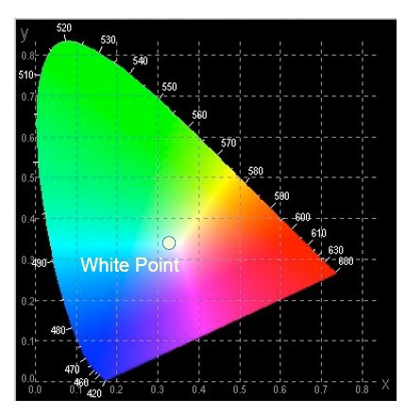
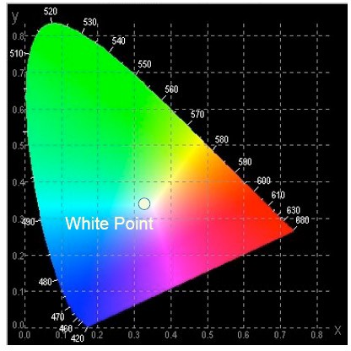
CIE Chromaticity Chart
Shows all the visible colors
Achromatic Colors are at (0.33,0.33).
– Called white point.
The saturated colors at the boundary.
– Spectral Colors
Adapted from Octavia Camps, Penn State

Slide 31
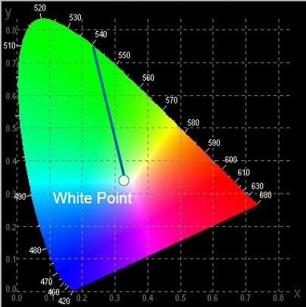
Chromaticity Chart: Hue
All colors on straight line from white point to a boundary has the same spectral hue.
– Dominant wavelength

Slide 32
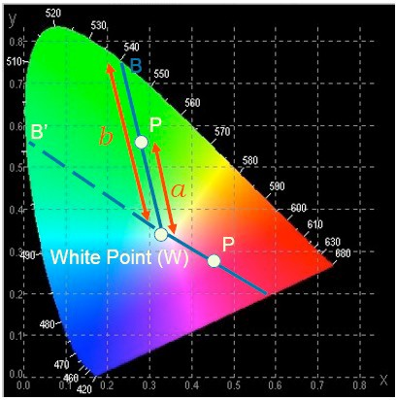
Chromaticity Chart: Saturation
Purity (Saturation)
How far shifted towards the spectral color?
Ratio of a/b
Purity =1 implies spectral color with maximum saturation.
Adapted from Octavia Camps, Penn State

Slide 33
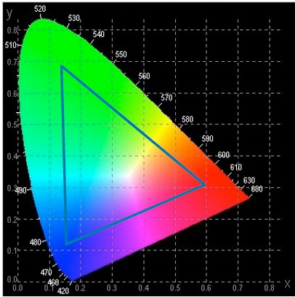
Color Reproducibility
Only a subset of the 3D CIE XYZ space called 3D color gamut.
Projection of the 3D color gamut.
–Triangle
–2D color gamut Large if using more
saturated primaries.
Cannot describe brightness range reproducibility.
Adapted from Octavia Camps, Penn State

Slide 34
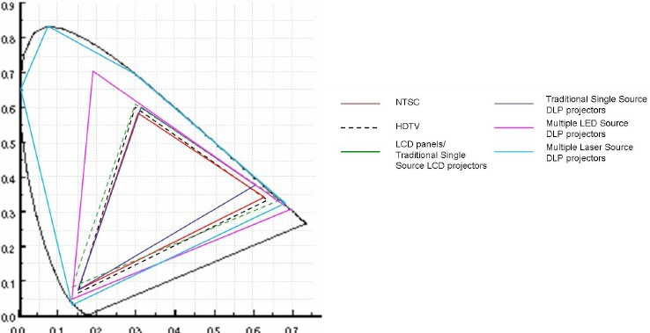
Standard Color Gamut
Adapted from Octavia Camps, Penn State

Slide 35
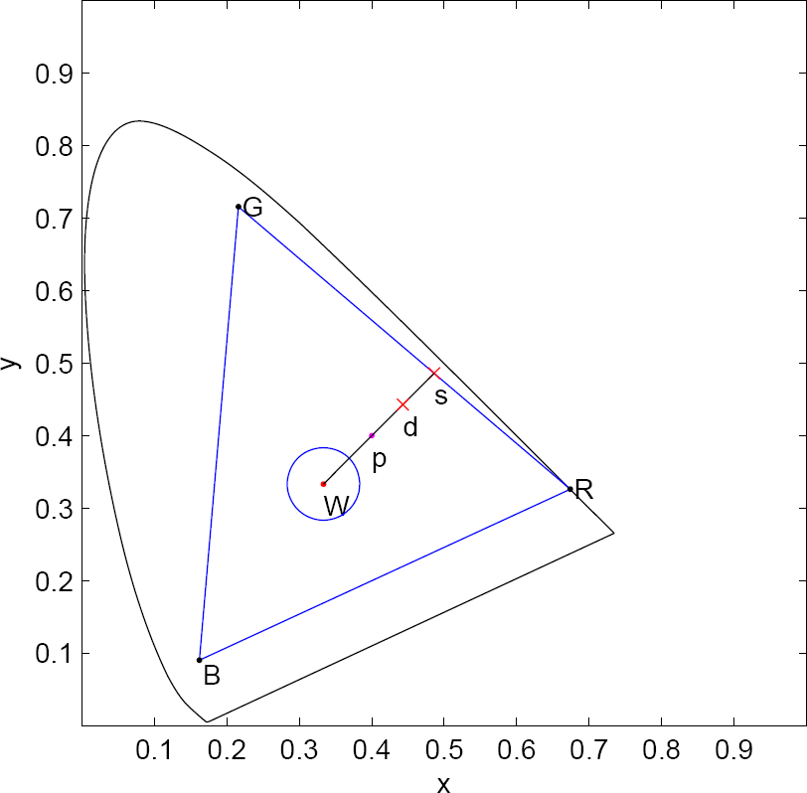
Saturation and De-saturation Operation
Move radially to the gamut edge ➔ Maximum Saturation given a hue.
Move inward using center of gravity law of color mixing.
Luca Lucchese, SK Mitra, J Mukherjee, A new algorithm based on saturation and desaturation in the xy chromaticity diagram for enhancement and re-rendition of color images, ICIP 2001.

Slide 36



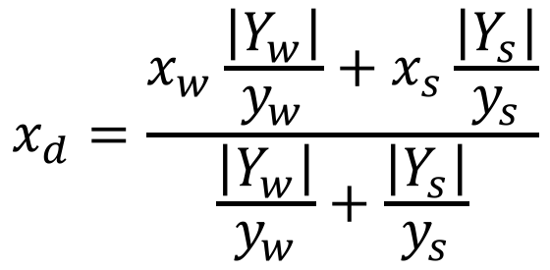
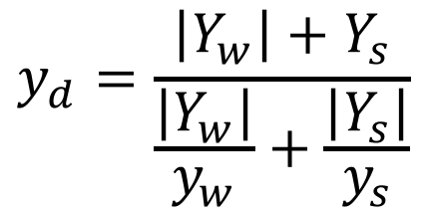


Desaturation using Center of Gravity Law
D=(x_{d},y_{d},Y_{d})
S=(x_{s},y_{s},Y_{s})
Weighted average of
W=(x_{w},y_{w},Y_{w})
chroma components.
Hunt, R.: Measuring Colour, 2nd Ed. Ellis Horwood Ltd. Publ., Chichester, UK (1987)

Slide 37
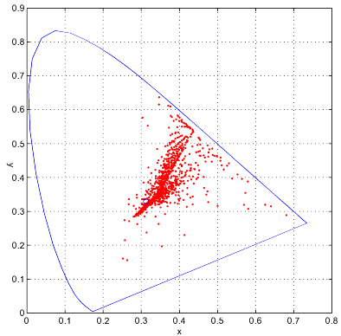
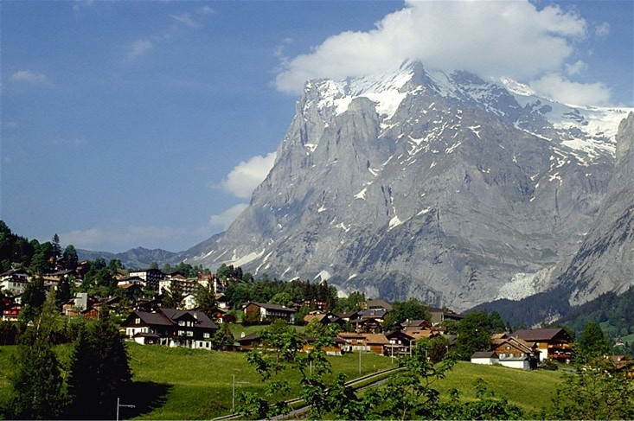
Alps - Original

Slide 38
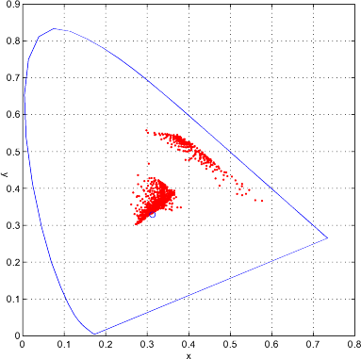
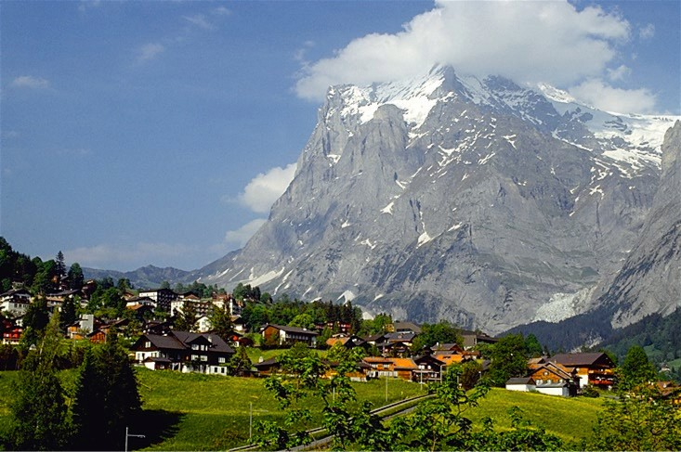
Saturated Image

Slide 39
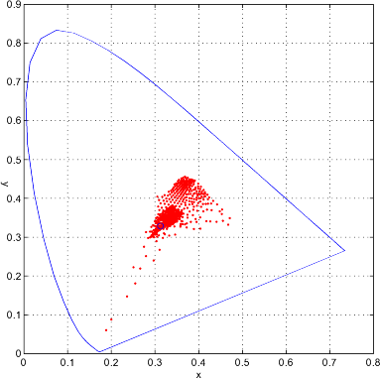
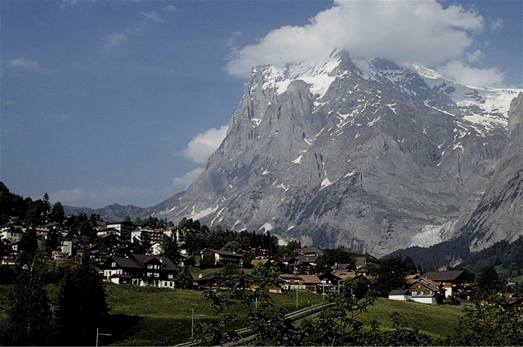
De-saturated Image

Slide 40


Saturated – De-saturated

Slide 41

Ex 1
Consider the following transformation matrix of color spaces (from RGB to XYZ).
(a) Given a color value in RGB space as (100, 80, 200) compute its corresponding point in the normalized x-y chromaticity space.

Slide 42


Ans. 1 (a)
(X, Y, Z)
x= X / (X+Y+Z)=113.8/397.4=0.2864
y= Y / (X+Y+Z)=84.8/397.4=0.2134

Slide 43
Ex. 1 (b)
Given the coordinates in the normalized x-y chromaticity space of three primary colors as ( 2/3, 1/ 3 ), (1/5, 3/4 ), and ( 1/6, 1/10 ),
compute the corresponding maximally saturated color in the RGB space preserving the same hue and intensity for the above point.

Slide 44

Ans. 1(b)
Move radially to the gamut edge ➔ Maximum Saturation given a hue.
Intersection of point between the line formed by an edge of the triangle and wq.
(1/5,3/4)
(1/3,1/3)
(2/3,1/3)
q (.2864,.2134)
(1/6,1/10)
Maximally saturated

Slide 45
Ans. 1(b)
Use projective space concepts. First check for BG and wq BG=(1/6 1/10 1) x (1/5 3/4 1)
= (-0.6500 0.0333 0.1050)
wq = (1/3 1/3 1) x (.2864 .2134 1)
=(0.1199 -0.0469
Intersection point
= BG x wq
-0.0243)
Not a point within the x-y space.
=(-0.0041 0.0032 -0.0265)
In non-homogeneous coordinates: (.1553, -.1216)

Slide 46
Ans. 1(b)
Use projective space concepts.
Next check for BR and wq (= (.1100 -.0469 -.0243))
BR=(1/6 1/10 1) x (2/3 1/3 1)
= (-0.2333 0.5000 -0.0111)
Intersection point = BR x wq
=(0.0127 0.0070 0.0490)
Maximally saturated point in x-y.
In non-homogeneous coordinates: (.2592, .1429)

Slide 47


Ans. 1(b)
Maximally saturated point in x-y.
(.2592, .1429)
Convert x-y to XYZ (keeping the intensity same) X=(397.4) x .2529=103.0061
Y=(397.4) x .1429 = 56.7885
Z=397.4 – (103.0061+56.7885)=237.6054
XYZ to RGB transformation matrix:
Convert from XYZ to RGB: (81.42 49.06 239.51)
(81, 49, 240)

Slide 48



Uniform color spaces
Differences in x,y coordinates do not reflect perceptual color differences.
CIE u’v’ is a projective transform of x,y to make the ellipses more uniform.
McAdam ellipses: Just noticeable differences in color
Adapted from Linda Shapiro, U of Washington

Slide 49



CIE Lab (L*a*b) model
One luminance channel (L*) and two color channels (a* and b*).
In this model, the color differences which we perceive correspond to Euclidean distances in CIE Lab.
The a axis extends from green (-a) to red (+a) and the b axis from blue (-b) to yellow (+b). The brightness (L) increases from the bottom to the top of the 3D model.
X_{n}, Y_{n} and Z_{n} are the reference white in XYZ space.
http://en.wikipedia.org/wiki/Lab_color_space
Adapted from Linda Shapiro, U of Washington

Slide 50
YIQ model
Have better compression properties.
Luminance Y is encoded using more bits than chrominance values I and Q (humans are more sensitive to Y than I and Q).
Luminance used by black/white TVs.
All 3 values used by color TVs.
Adapted from Octavia Camps, Penn State
63

Slide 51


Slide 52

YCbCr space
Have better compression properties. Used in image and video compression schemes.
Y represents the luminance, and Cb and Cr are chrominance parts.
Not a linear transformation, affine.
Cb and Cr translated to bring them within the range of 0 to 240 assuming ranges of R, G and B
are 0 to 255.
Adapted from Octavia Camps, Penn State
64

Slide 53



Nonlinear color spaces: HSV
Perceptually meaningful dimensions: Hue, Saturation, Value (Intensity)
Adapted from Linda Shapiro, U of Washington

Slide 54
HSI Model:
The HSI color model represents every color with three components: hue (H), saturation (S), intensity (I).
The Hue component describes the color in the form of an angle between [0,360] degrees.
The Saturation component describes how much the color is diluted with white light.
The range of the S varies between [0,1]. The Intensity range is between [0,1] and 0 means black, 1 means white.

Slide 55


Slide 56


Slide 57
Opponent Color Processing
The color opponent process: A theory proposed on perception of color by processing signals from cones and rods in an antagonistic manner.
Overlapping spectral zone of three types of cones (L for long, M for medium and S for short).
The visual system considered to record differences between the responses of cones, rather than each type of cone's individual response.
People don’t perceive reddish-greens, or bluish-yellows.

Slide 58

Opponent Color Processing
The opponent process theory accounts for mechanisms that receive and process information from cones.
By Googolplexbyte - Own work, CC BY-SA 3.0, https://commons.wikimedia.org/w/index.php?curid=25539422

Slide 59

Opponent Color Processing
Three opponent channels: Red vs. Green, (G-R)
Blue vs. Yellow, (B-Y) or (B-(R+G)) and
Black vs. White, (Luminance: e.g. (R+G+B)/3).
Y-Cb’-Cr’ follows opponent color space representation.

Slide 60
Summary
Color is an important information for interpreting images and videos.
Color is captured in the RGB color space: Not suitable for direct interpretation of color components such as Hue and Saturation.
CIE Chromaticity Chart represents colors in a 2-D space according to tri-stimulus model of color representation and capable of providing the gamut triangle for reproducing colors.
Various other color spaces used for processing.

